Slide 1

Virtual Internship 6.0 – Infosys Springboard
Smart Home Energy Management System
Mounika
Under the Guidance of: Dr.T.Premalatha
Module 2:Smart Device Management

Slide 2


Module Overview & System Context
A comprehensive approach to managing residential energy through intelligent device control and secure user validation.
Core Focus: Module 2
The module serves as the primary engine for controlling hardware states and monitoring consumption.
Dependency: Module 1
The acts as a gatekeeper, ensuring that only verified residents can access power-hungry appliances.
User
Authentication
Smart Device Management

Slide 3


Module 1: Authentication Module
Security is the foundation of IoT. Unauthorized access to home systems poses both physical and data security risks.
Identity Validation
Verifies user credentials against the secure central database to prevent spoofing.
Access Control
Implements Role-Based Access Control (RBAC) to limit device permissions.
Session Management
Maintains secure tokens to ensure commands are issued within a valid time window.

Slide 4
Authentication – Pseudocode Logic
// User (User Details Holder)CLASS User userId fullName emailId username password userRoleEND CLASS// AuthController (Handles User Requests)CLASS AuthController FUNCTION registerUser(userInfo) call AuthService.register(userInfo) END FUNCTION FUNCTION loginUser(loginInfo) call AuthService.login(loginInfo) END FUNCTION FUNCTION resetPassword(email) call AuthService.resetPassword(email) END FUNCTIONEND CLASS

Slide 5
🔹 AuthService (Authentication Logic)
CLASS AuthService
FUNCTION register(userInfo)
IF user already exists THEN
display "User already registered"
ELSE
save user details
display "Registration successful"
END IF
END FUNCTION
FUNCTION login(loginInfo)
IF credentials are valid THEN
create session
grant access based on role
ELSE
display "Login failed"
END IF
END FUNCTION
FUNCTION resetPassword(email)
IF email exists THEN
send password reset link
ELSE
display "Email not found"
END IF
END FUNCTION
END CLASS

Slide 6
🔹 UserRepository (Database Interaction)
CLASS UserRepository
FUNCTION saveUser(user)
store user data in database
END FUNCTION
FUNCTION getUser(username)
retrieve user from database
END FUNCTION
END CLASS

Slide 7
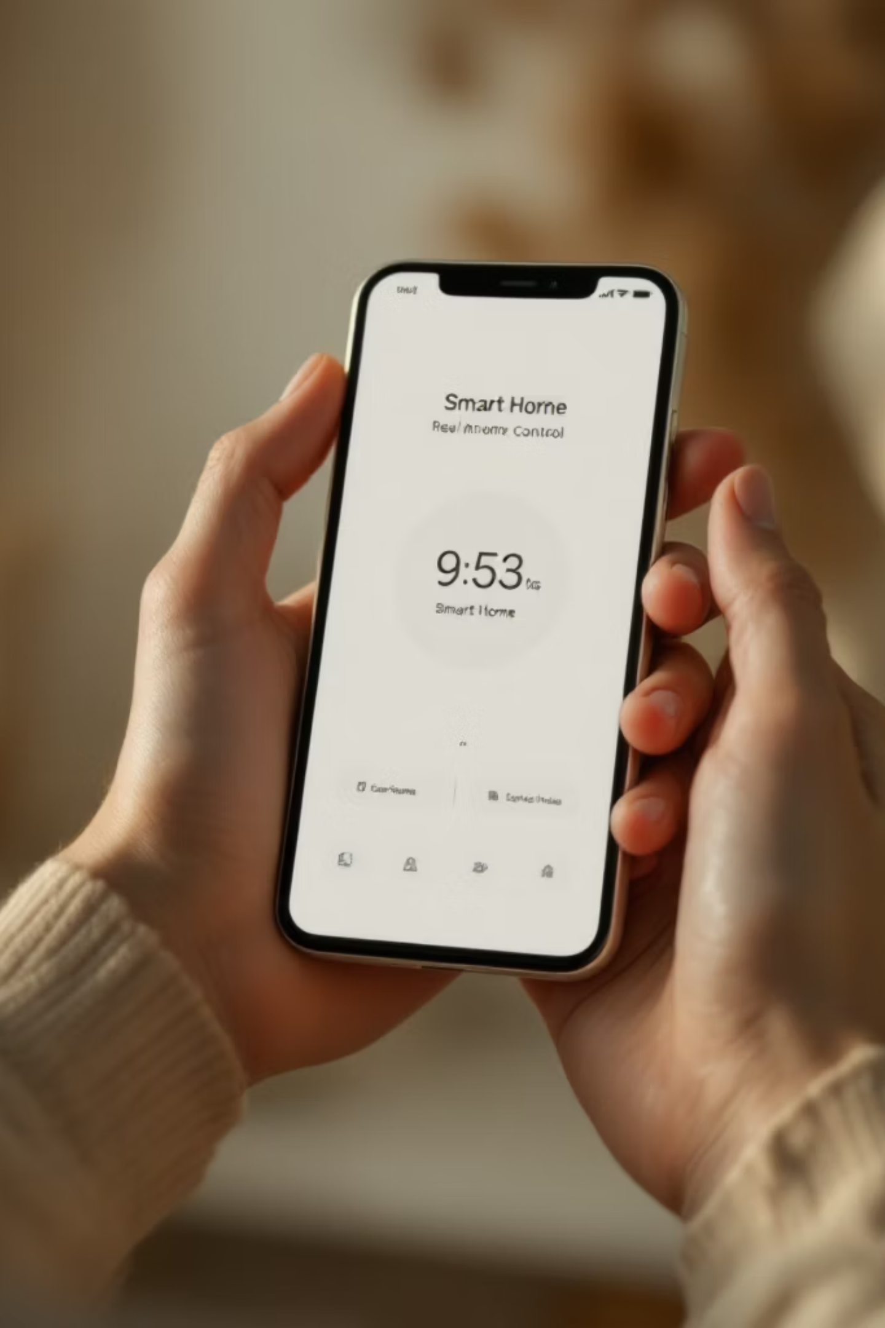



Module 2: Smart Device Management
This module facilitates real-time interaction between the user interface and physical hardware components.
Lighting Control
Climate Systems
Smart LEDs with dimming and scheduling capabilities.
Intelligent control of Fans and Air Conditioning units.
Appliances
Monitoring high-load kitchen and utility appliances.

Slide 8
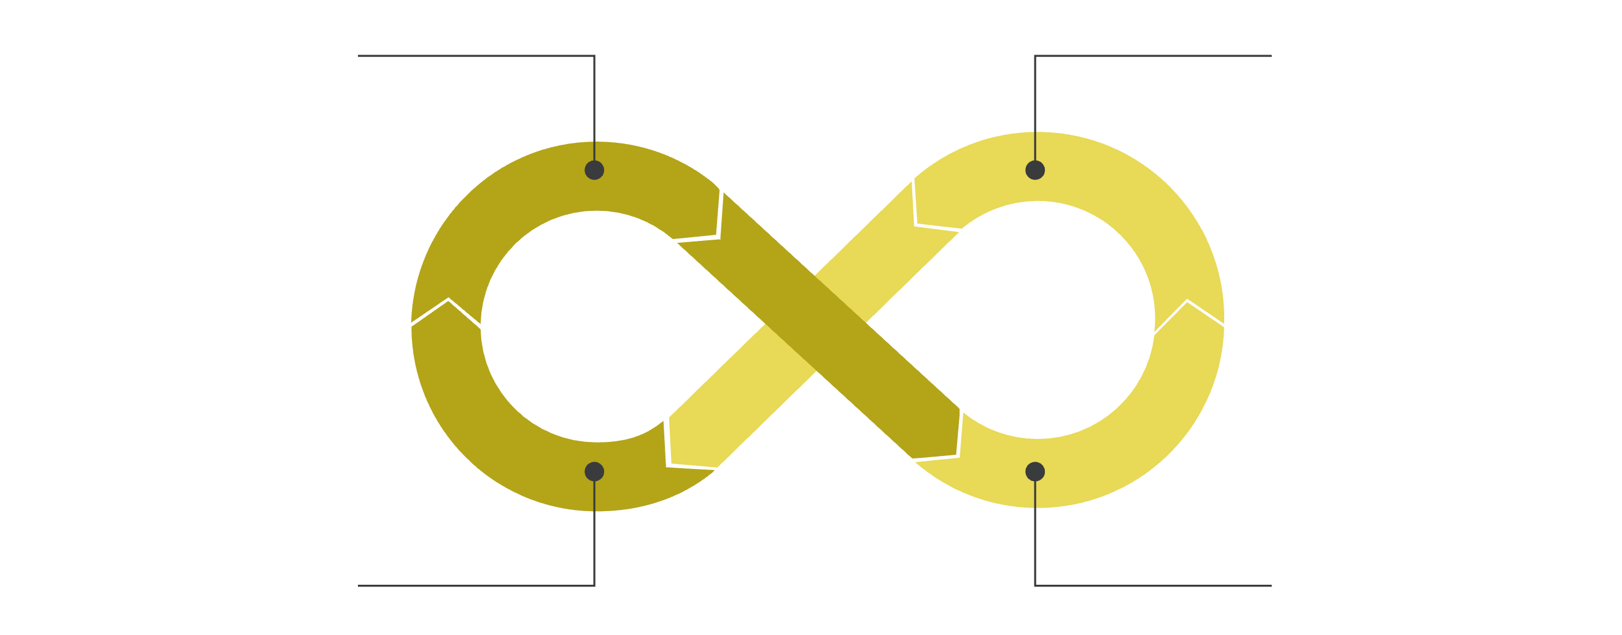
Working Flow – Device Management
From user intent to hardware execution: A systematic cycle of command and feedback.
01
02
Success Login
Device Selection
User passes the Module 1 security check.
User chooses a specific device (e.g., Living Room AC) from the UI.
03
04
Command Dispatch
State & Log
The system sends an ON/OFF or Set-Point signal via MQTT/HTTP.
The device state updates in the DB and energy metrics are recorded.
Login
Select Device
Update Status
Command

Slide 9
Smart Device Management – Pseudocode
A clean implementation of device state transitions using Spring Boot Services.
🔹 SmartDevice (Device Information Holder)
CLASS SmartDevice
deviceId
deviceName
category
currentStatus
energyConsumption
END CLASS
🔹 DeviceController (Handles User Requests)
CLASS DeviceController
FUNCTION registerDevice(deviceData)
call DeviceService.register(deviceData)
END FUNCTION
FUNCTION switchOn(deviceId)
call DeviceService.activate(deviceId)
END FUNCTION
FUNCTION switchOff(deviceId)
call DeviceService.deactivate(deviceId)
END FUNCTION
END CLASS

Slide 10
🔹 DeviceService (Main Business Logic)
CLASS DeviceService
FUNCTION register(deviceData)
save device details
END FUNCTION
FUNCTION activate(deviceId)
update device status as ON
END FUNCTION
FUNCTION deactivate(deviceId)
update device status as OFF
END FUNCTION
END CLASS
🔹 DeviceRepository (Database Operations)
CLASS DeviceRepository
FUNCTION saveDevice(device)
store device in database
END FUNCTION
FUNCTION getDevice(deviceId)
fetch device from database
END FUNCTION
END CLASS

Slide 11



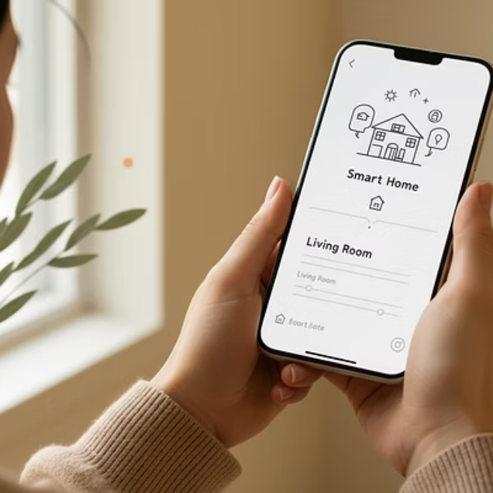
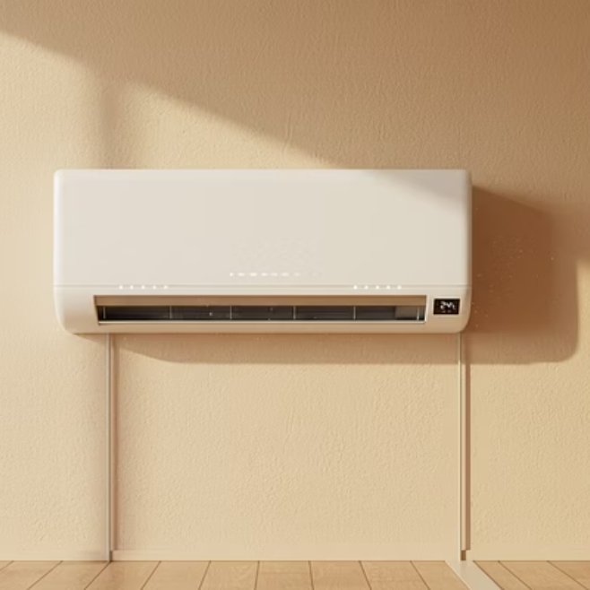
Real-Time Use Case Scenario
Bridging the gap between software logic and everyday convenience.
1. Action
2. Verification
3. Execution
User turns ON the AC via mobile app while commuting.
Cloud system validates the user's remote session.
Smart AC triggers; consumption spikes are logged instantly.

Slide 12


System Integration Architecture
How Module 1 (Auth) and Module 2 (Management) create a unified, secure ecosystem.
Frontend
Provides the user interface via mobile apps and web platforms, allowing users to intuitively control and monitor their smart home devices from anywhere.
Backend
Secure Energy Control
Manages all server-side operations, including user authentication, data processing, device communication protocols, and secure API access, ensuring reliable and protected system functionality.
Authentication
Device Management
Device with Sensor
Represents the physical smart home devices (e.g., smart AC, lights) and embedded sensors that execute commands from the backend and collect real-time environmental data, feeding it back into the system.

Slide 13
Conclusion & Key Takeaways
The Smart Home Energy Management System represents the future of responsible resource consumption.
Sustainability
Security
Scalability
Granular control leads to significant reductions in wasted electricity.
Robust authentication protects the home from external digital threats.
The Spring Boot architecture allows for adding hundreds of new device types.
Thank You!
Virtual Internship 6.0 | Infosys Springboard

